Slide 1
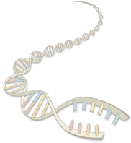
Fragment Assembly
(in whole-genome shotgun sequencing)
CS273a Lecture 5

Slide 2
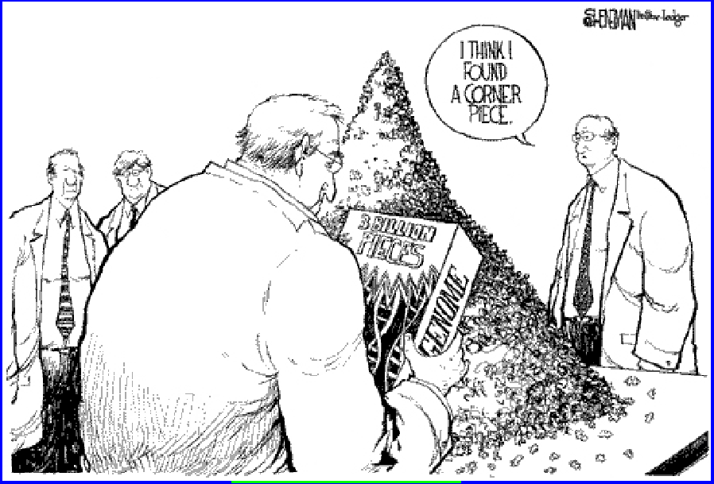
Fragment Assembly
Given N reads…
Where N ~ 30 million…
We need to use a linear-time algorithm
CS273a Lecture 5

Slide 3
Steps to Assemble a Genome
Some Terminology
read a 500-900 long word that comes
out of sequencer
mate pair a pair of reads from two ends
of the same insert fragment
contig a contiguous sequence formed
by several overlapping reads
with no gaps
supercontig an ordered and oriented set
(scaffold) of contigs, usually by mate
pairs
consensus sequence derived from the
sequene multiple alignment of reads
in a contig
1. Find overlapping reads
2. Merge some “good” pairs of reads into longer contigs
3. Link contigs to form supercontigs
4. Derive consensus sequence
..ACGATTACAATAGGTT..
CS273a Lecture 5

Slide 4
1. Find Overlapping Reads
(read, pos., word, orient.)
aaactgcag
aactgcagt
actgcagta
…
gtacggatc
tacggatct
gggcccaaa
ggcccaaac
gcccaaact
…
actgcagta
ctgcagtac
gtacggatc
tacggatct
acggatcta
…
ctactacac
tactacaca
(word, read, orient., pos.)
aaactgcag
aactgcagt
acggatcta
actgcagta
actgcagta
cccaaactg
cggatctac
ctactacac
ctgcagtac
ctgcagtac
gcccaaact
ggcccaaac
gggcccaaa
gtacggatc
gtacggatc
tacggatct
tacggatct
tactacaca
aaactgcagtacggatct
aaactgcag
aactgcagt
…
gtacggatct
tacggatct
gggcccaaactgcagtac
gggcccaaa
ggcccaaac
…
actgcagta
ctgcagtac
gtacggatctactacaca
gtacggatc
tacggatct
…
ctactacac
tactacaca
CS273a Lecture 5

Slide 5
1. Find Overlapping Reads
Find pairs of reads sharing a k-mer, k ~ 24
Extend to full alignment – throw away if not >98% similar
TACA
TAGATTACACAGATTAC
T GA
||
|||||||||||||||||
| ||
TAGT
TAGATTACACAGATTAC
TAGA
Caveat: repeats
  A k-mer that occurs N times, causes O(N²) read/read comparisons
  ALU k-mers could cause up to 1,000,000² comparisons
Solution:
  Discard all k-mers that occur “too often”
    Set cutoff to balance sensitivity/speed tradeoff, according to genome at hand and computing resources available
CS273a Lecture 5

Slide 6
1. Find Overlapping Reads
Create local multiple alignments from the overlapping reads
TAGATTACACAGATTACTGA
TAGATTACACAGATTACTGA
TAG TTACACAGATTATTGA
TAGATTACACAGATTACTGA
TAGATTACACAGATTACTGA
TAGATTACACAGATTACTGA
TAG TTACACAGATTATTGA
TAGATTACACAGATTACTGA
CS273a Lecture 5

Slide 7
1. Find Overlapping Reads
Correct errors using multiple alignment
TAGATTACACAGATTACTGA
TAGATTACACAGATTACTGA
TAGATTACACAGATTACTGA
TAGATTACACAGATTACTGA
TAGATTACACAGATTATTGA
TAG-TTACACAGATTATTGA
TAGATTACACAGATTACTGA
TAGATTACACAGATTACTGA
TAG-TTACACAGATTACTGA
TAG-TTACACAGATTATTGA
insert A
correlated errors—
probably caused by repeats
⇒ disentangle overlaps
replace T with C
TAGATTACACAGATTACTGA
TAGATTACACAGATTACTGA
TAGATTACACAGATTACTGA
In practice, error correction removes
up to 98% of the errors
TAG-TTACACAGATTATTGA
TAG-TTACACAGATTATTGA
CS273a Lecture 5

Slide 8
2. Merge Reads into Contigs
Overlap graph:
  Nodes: reads r₁…..r_{n}
  Edges: overlaps (r_{i}, r_{j}, shift, orientation, score)
Reads that come
from two regions of
the genome (blue
and red) that contain
the same repeat
Note:
of course, we don’t
know the “color” of
these nodes
CS273a Lecture 5

Slide 9
2. Merge Reads into Contigs
repeat region
Unique Contig
Overcollapsed Contig
We want to merge reads up to potential repeat boundaries
CS273a Lecture 5

Slide 10
2. Merge Reads into Contigs
r
r₁
r₂
r₃
Remove transitively inferable overlaps
  If read r overlaps to the right reads r₁, r₂, and r₁ overlaps r₂, then (r, r₂) can be inferred by (r, r₁) and (r₁, r₂)
CS273a Lecture 5

Slide 11
2. Merge Reads into Contigs
CS273a Lecture 5

Slide 12

2. Merge Reads into Contigs
repeat boundary???
sequencing error
b
a
…
b
a
Ignore “hanging” reads, when detecting repeat boundaries
CS273a Lecture 5

Slide 13
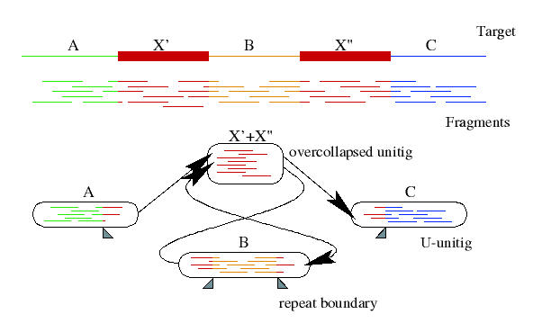
Overlap graph after forming contigs
Unitigs:
Gene Myers, 95
CS273a Lecture 5

Slide 14
Repeats, errors, and contig lengths
Repeats shorter than read length are easily resolved
  Read that spans across a repeat disambiguates order of flanking regions
Repeats with more base pair diffs than sequencing error rate are OK
  We throw overlaps between two reads in different copies of the repeat
To make the genome appear less repetitive, try to:
  Increase read length
  Decrease sequencing error rate
Role of error correction:
Discards up to 98% of single-letter sequencing errors
decreases error rate
⇒ decreases effective repeat content
⇒ increases contig length
CS273a Lecture 5

Slide 15
3. Link Contigs into Supercontigs
Normal density
Too dense
⇒ Overcollapsed
Inconsistent links
⇒ Overcollapsed?
CS273a Lecture 5

Slide 16
3. Link Contigs into Supercontigs
Find all links between unique contigs
Connect contigs incrementally, if ≥ 2 forward-reverse links
supercontig
(aka scaffold)
CS273a Lecture 5

Slide 17
3. Link Contigs into Supercontigs
Fill gaps in supercontigs with paths of repeat contigs
Complex algorithmic step
  Exponential number of paths
  Forward-reverse links
CS273a Lecture 5

Slide 18
4. Derive Consensus Sequence
TAGATTACACAGATTACTGA TTGATGGCGTAA CTA
TAGATTACACAGATTACTGACTTGATGGCGTAAACTA
TAG TTACACAGATTATTGACTTCATGGCGTAA CTA
TAGATTACACAGATTACTGACTTGATGGCGTAA CTA
TAGATTACACAGATTACTGACTTGATGGGGTAA CTA
TAGATTACACAGATTACTGACTTGATGGCGTAA CTA
Derive multiple alignment from pairwise read alignments
Derive each consensus base by weighted voting
(Alternative: take maximum-quality letter)
CS273a Lecture 5

Slide 19
Some Assemblers
PHRAP
    Early assembler, widely used, good model of read errors
    Overlap O(n²) → layout (no mate pairs) → consensus
Celera
    First assembler to handle large genomes (fly, human, mouse)
    Overlap → layout → consensus
Arachne
    Public assembler (mouse, several fungi)
    Overlap → layout → consensus
Phusion
    Overlap → clustering → PHRAP → assemblage → consensus
Euler
    Indexing → Euler graph → layout by picking paths → consensus
CS273a Lecture 5

Slide 20
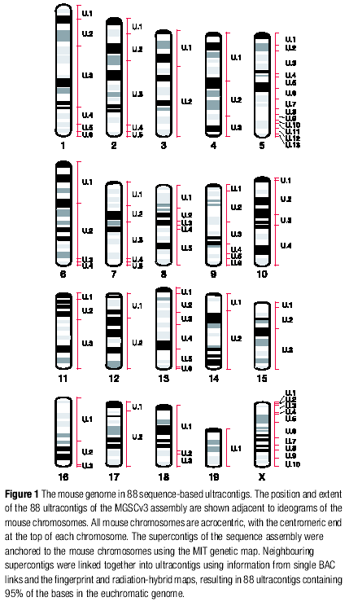
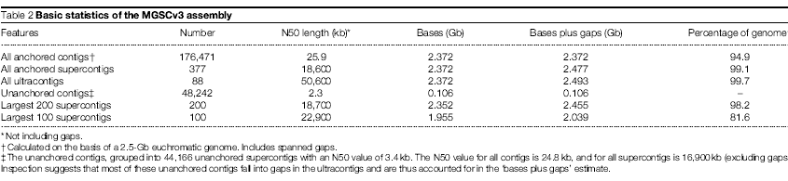
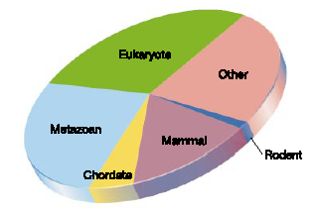
Quality of assemblies—mouse
Terminology: N50 contig length
If we sort contigs from largest to smallest, and start
Covering the genome in that order, N50 is the length
Of the contig that just covers the 50th percentile.
7.7X
sequence
coverage
CS273a Lecture 5

Slide 21
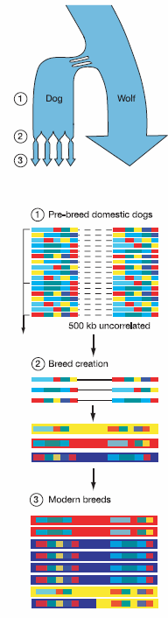
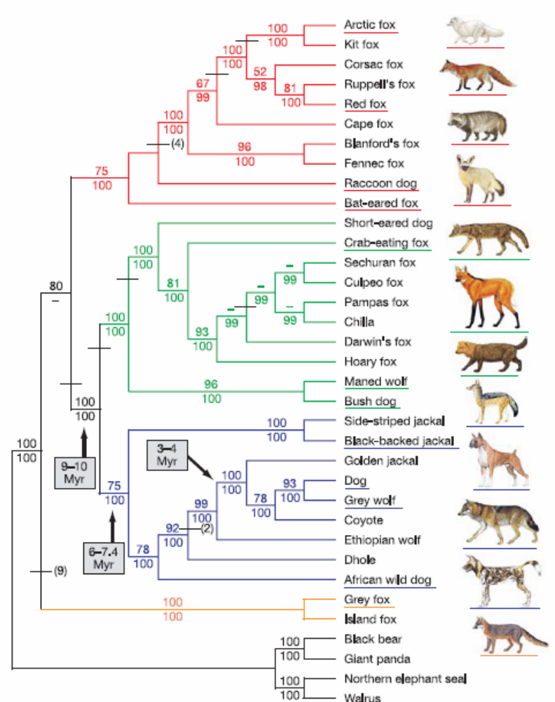
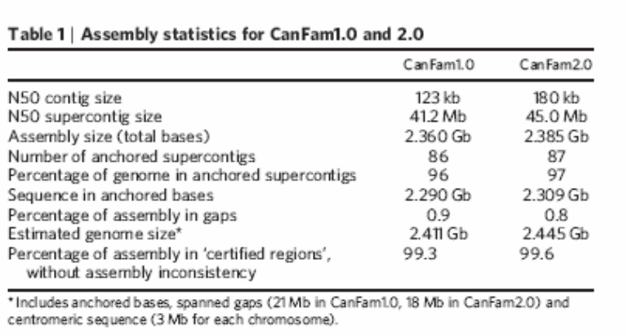
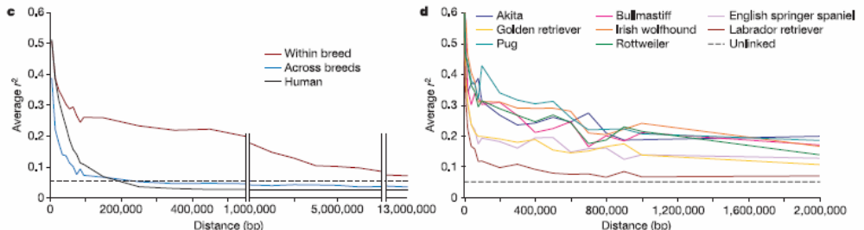
Quality of assemblies—dog
7.5X
sequence
coverage
CS273a Lecture 5

Slide 22
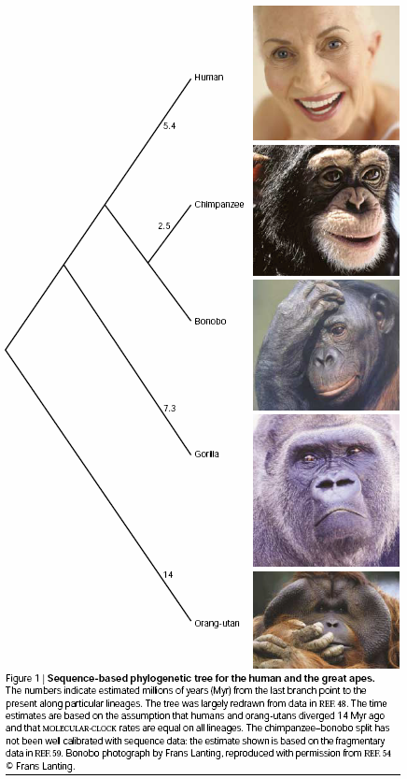
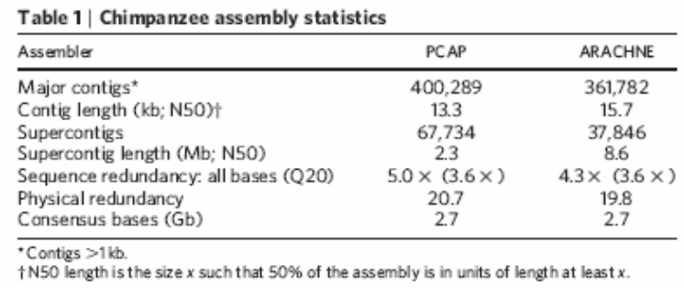
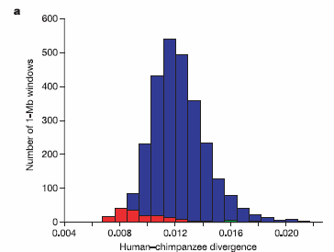
Quality of assemblies—chimp
3.6X
sequence
Coverage
Assisted
Assembly
CS273a Lecture 5

Slide 23
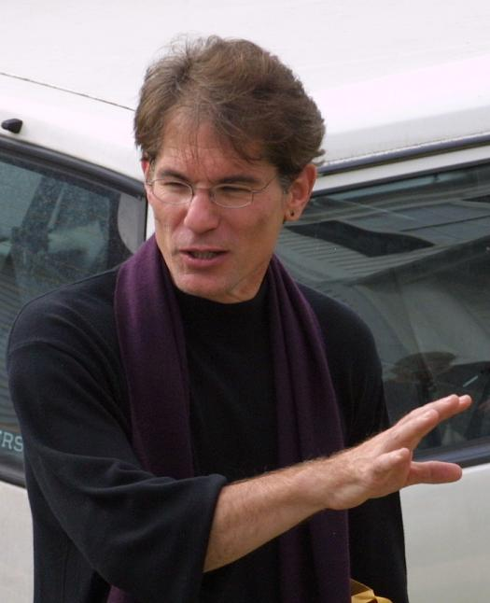
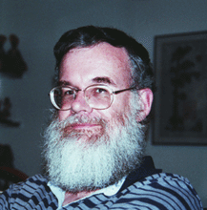
History of WGA
1997
1982: λ-virus, 48,502 bp
1995: h-influenzae, 1 Mbp
2000: fly, 100 Mbp
2001 – present
  human (3Gbp), mouse (2.5Gbp), rat*, chicken, dog, chimpanzee, several fungal genomes
Let’s sequence the human genome with the shotgun strategy
That is impossible, and a bad idea anyway
Phil Green
Gene Myers
CS273a Lecture 5

Slide 24

Sequencing and Assembly:
Moving from a few genomes to a few million genomes

Slide 25
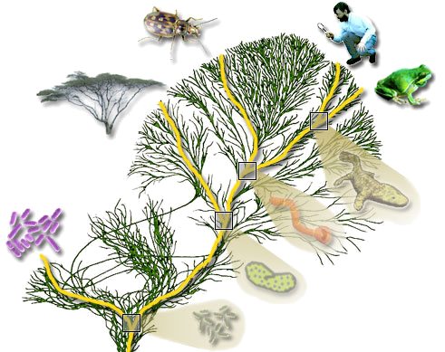
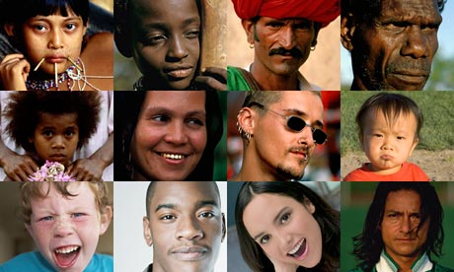

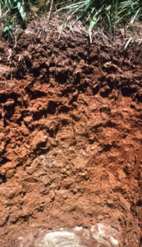
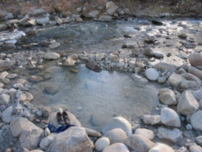
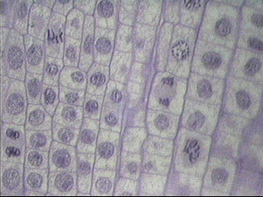
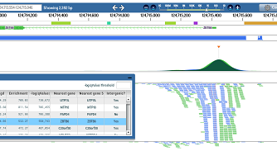
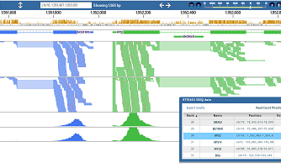
Unlimited Uses for Sequencing
100 million species
Personal Genomes
Somatic mutations
Cancer
Retroviruses
Functional Assays

Slide 26
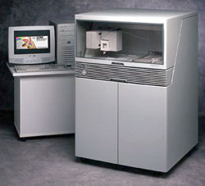
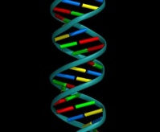
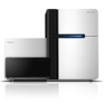
Sequencing and Assembly Varieties
De novo assembly
Variation Calling
AGTAGCACAGACTACGACGAGACGATCGTGCGAGCGACGGCGTAGTGTGCTGTACTGTCGTGTGTGTGTACTCTCCT
Metagenomics
Functional Genomics

Slide 27
Human (and other) Genome Variation
TGCTGAGA
TGCCGAGA
TGCTCGGAGA
TGC - - - GAGA
SNP
Novel Sequence
Mobile Element or
Pseudogene Insertion
Inversion
Translocation
Tandem Duplication
TGC - - AGA
TGCCGAGA
Microdeletion
Transposition
Novel Sequence
at Breakpoint
Large Deletion
TGC
CS273a Lecture 5

Slide 28
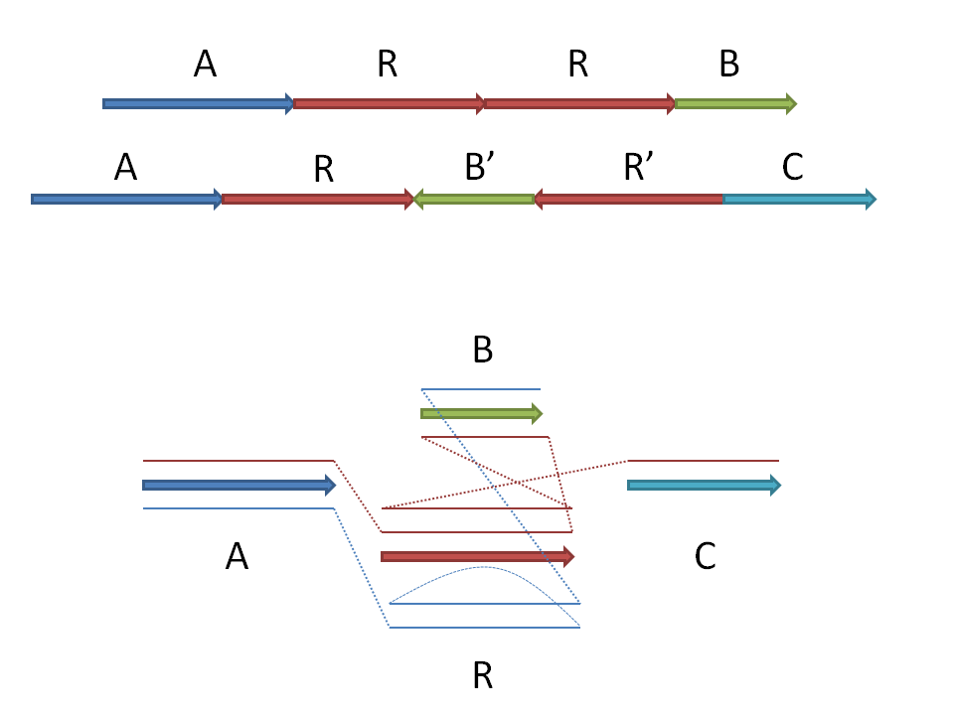
Representing Genome Variation
Multi-Assembly Graph
A-Brujin graph representation
Block A
TGCCGAGAGTATAGGCTAGACTGACGA
TGCTGAGA - TATAGGGTAGACTCACGA
TGCTGAGAGTATAGGGTAGACTGTCGA
TGCCGAGTGTATAGGCTACACTGACGA
TACCGAGTGTATAGGCTACACTGACGA
CS273a Lecture 5

Slide 29
How Soon will Everyone be Sequenced?
Cost
Killer app
Roadblocks?
Value
Cost
Time
2012?
2020?
Computational challenges in human genome variation
        Discovery
        Representation
        Interpretation
CS273a Lecture 5

